Slide 1
Topic 10
Heap, Set and Map
資料結構與程式設計
Data Structure and Programming
12/05/2018

Slide 2
Linear Data Types
In previous topic and Homework #5, we have learned linear data types like list and array
  Tradeoffs between insert/delete/find operators
  Memory overhead
➔ Constant time for “push_back()” or “push_front()” operation
The best way to use linear data types is ---
  Data are recorded in a linear sequence (i.e. only push_back or push_front is needed)
  Linearly traverse each element (i.e. for(...; li++))
  No “find”, “insert any”, nor “delete any”
  ➔ If needed, use “tree”?

Slide 3
Consider the Scenario...
Suppose we are assigning jobs sequentially to several machines ---
  One job to one machine and we record the accumulated runtime for each machine.
  Our machine selection criteria is to “even out” the runtime of the machines.
  In other words, we would like to pick the machine with least accumulated runtime for the next job
➔ Do we need to sort ALL the elements?
➔ Need a priority queue

Slide 4
Priority Queue
An ADT that supports 2 operations
  Insert
  Delete min(or max)
An element with arbitrary priority can be inserted to the queue
At any time, it should take constant time to find the element with min(or max) priority and could efficiently remove it from the list
  Need to figure out which is the one with next lowest(highest) priority efficiently

Slide 5
Using List or Array?
Use linear ADT with an extra field to record the element with min(max) priority
  Insert: O(1)
  Delete min(max): O(n)
  (why?)
As we learn before, O(n) is not good. We would prefer an ADT with O(log n) for both operations

Slide 6
Min (Max) Heap
A complete binary tree in which the key value in each node is no larger (smaller) than its children
4
9
10
12
7
16
23
25
20
18
26
25
Why complete binary tree?

Slide 7
Remember that we can use array to implement a complete binary tree...
Parent
= child / 2
Child
= Parent * 2
or Parent * 2 + 1
1
2
3
4
5
6
1
2
3
4
5
6

Slide 8
MinHeap Insertion
// Let n be the index of the last element
void MinHeap::insert(const T& x)
{
int t = ++n; // next to the last
while (t > 1) {
int p = t / 2;
if (x._key >= _heap[p]._key)
break;
_heap[t] = _heap[p];
t = p;
}
_heap[t] = x;
}
4
7
12
20
18
26
x
What’s the time complexity?

Slide 9
Delete Min Element
T& MinHeap::deleteMin()
{
T ret = _heap[1];
int p = 1, t = 2 * p;
while (t <= n) {
if (t < n) // has right child
if (_heap[t]._key > _heap[t+1]._key)
++t; // to the smaller child
if (_heap[n]._key < _heap[t]._key)
break;
_heap[p] = _heap[t];
p = t;
t = 2 * p;
}
_heap[p] = _heap[n--];
return ret;
}
4
7
12
20
18
26
What’s the time complexity?

Slide 10
Min(Max) Heap
Simple implementation (just an array)
Good insertion and deleteMin complexity
  O(log n) vs. O(n)
What if you want to
delete min AND delete max?

Slide 11
Min-Max Heap
7
min
70
40
max
30
9
10
15
min
45
50
30
20
16
max
Insert, delete min, delete max: all O(log n) (why?)

Slide 12
Deap
Double-ended heap
  The root contains no element
  The left subtree is a min heap
  The right subtree is a max heap
  Let i be any node in the left subtree. Let j be the corresponding node in the right subtree. If such a j node does not exist, then let j be the corresponding parent of i. ➔ The key in node i is less than or equal to that in j.

Slide 13
Deap Example
5
45
10
8
25
40
15
19
9
30
20
Insert, delete min, delete max: all O(log n) (why?)
  But faster than min-max heap by a constant factor
  Algorithm is simpler

Slide 14
Deap Implementation
0
Numbers are indices in array, not data value
1
2
3
4
5
6
7
8
9
10
11
12
Given a node ‘i’, how to find the “corresponding parent” or “corresponding child”?
When insertion or deletion, what should we do when the node value is greater/smaller than its corresponding parent/child?

Slide 15
Practice #1
Write the pseudo codes for the “insert”, “delete min”, and “delete max” operations of the min-max heap.
Write the pseudo codes for the “insert”, “delete min”, and “delete max” operations of the deap.

Slide 16
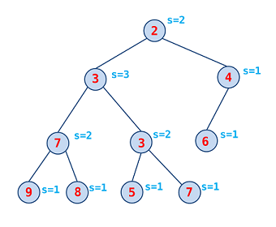
More Varieties of Heaps: Leftist Heap
In contrast to a binary heap, a leftist heap attempts to be very unbalanced.
  s-value(v):
  the distance to the
  nearest leaf.
  In addition to the
  heap property,
  the right child of
  each node has the
  lower s-value.
Support
“combine(heap1, heap2)” in O(log n)

Slide 17
Leftist Heap: Huh?
Remember: “combine(heap1, heap2)” in O(log n)
  Both“insert” and “deleteMin” operations can be realized by “combine”. (How?)
combine(h₁, h₂) {
compare(min(h₁), min(h₂));
// let min(h_{i}) < min(h_{j})
if (right(h_{i}) == NULL)
right(h_{i}) = h_{j};
else
combine(right(h_{i}), h_{j});
// hj is now the combined heap
if (s(right(h_{j})) > s(left(h_{j}))
swap(right(h_{j}), left(h_{j}));
}

Slide 18
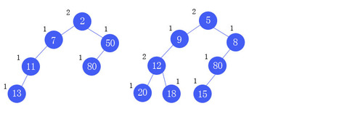
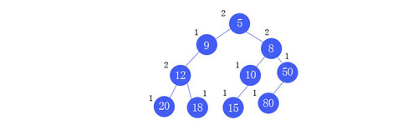
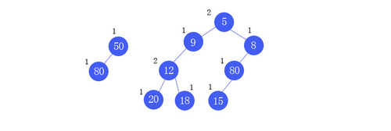
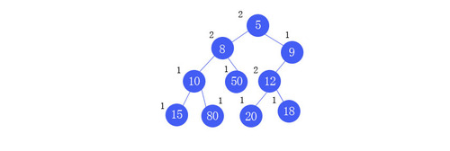
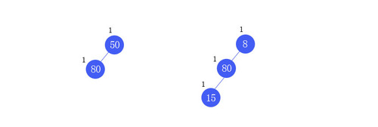
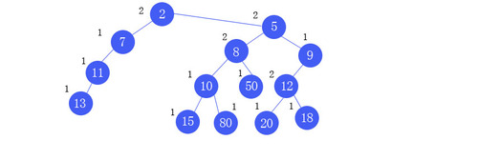
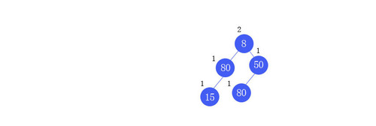
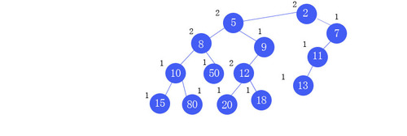
Leftist Heap: Combine
[src] http://blog.yam.com/rockmanray/article/44962825
2 > 1
Swap
2 < 5
right != NULL
Recursion returns;
Combine with 2
5 < 50
right != NULL
2 > 1
Swap
8 < 50
right = NULL
Done!
Recursion returns;
Combine with 5

Slide 19
Leftist Heap: Discussion
How can “insert” and “delete” be implemented by “combine”?
Can we implement “combine” efficiently in a min-heap?
Can the leftist heap be implemented in an array, like a min-heap does?

Slide 20
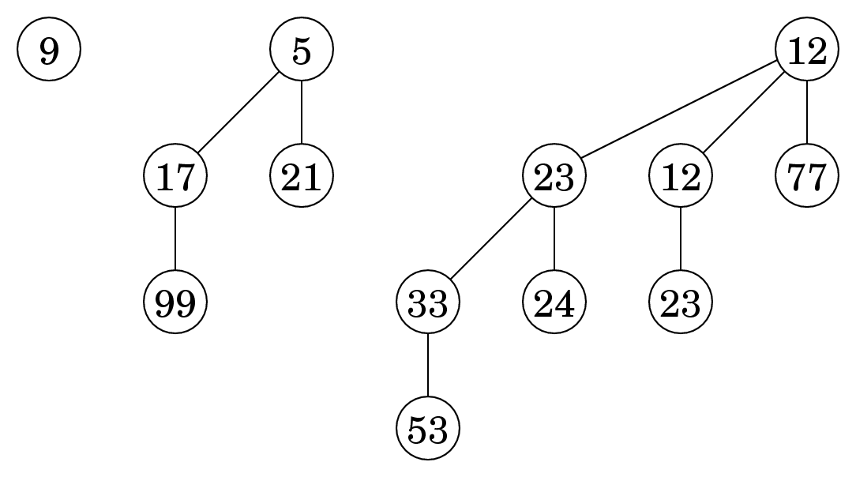
More Varieties of Heaps: Binomial heap
Binomial tree of order k
  Binomial tree of order 0 is a single node
  The root of a binomial tree of order k has k children, who are roots of binomial trees of order k-1, k-2,..., 0
  Has exactly 2^{k} nodes; height = k
Binomial heap
  A collection of Binomial trees
  Most operations have
  the complexity
  O(log n)
  But the amortized
  complexity is either
  O(1) or O(log n)

Slide 21
Binomial Heap: Properties
Given a binomial heap with n nodes:
  The node containing the min element is a root of B₀, B₁, …, or B_{k}.
  It contains the binomial tree B_{i} iff b_{i} = 1, where b_{k}… b₂ b₁ b₀ is binary representation of n.
  It has ≤ ⎣log₂ n⎦ + 1 binomial trees.
  Its height ≤ ⎣log₂ n⎦.
[src] http://www.cs.princeton.edu/~wayne/kleinberg-tardos/pdf/BinomialHeaps.pdf

Slide 22
Binomial Heap: Operations
Similar to Leftist Heap, the operations of Binomial Heap can be realized by the “compose” (aka. “meld”) operation.
Compose operation:
  Binary addition
  Given two binomial heaps
  H₁ := { (B₃, B₂, B₁, B₀) = (1, 1, 0, 1) }, and
  H₂ := { (B₄, B₃, B₂, B₁, B₀) = (1, 0, 1, 0, 1) }.
  The composed binomial heap
  H_{m} := { (B₅, B₄, B₃, B₂, B₁, B₀) = (1, 0, 0, 0, 1, 0) }.

Slide 23
Binomial Heap: Compose Operation
Atomic operation:
  Given two binomial trees B_{i}, B_{j}, with the same order k, then compose(B_{i}, B_{j}):
  Connect the roots r_{i}, r_{j} of B_{i}, B_{j}.
  Choose min(r_{i}, r_{j}) as the root of the composed tree
  The composed tree is of order k+1
  ➔ What’s the time complexity?
  ➔ What if we have three binomial trees with the same order?
The compose operation of two binomial heaps:
  Align the binomial trees of both heaps
  From the trees with the least order, perform tree composition
  Propagate to the next order of tree if necessary
What’s the time complexity?
O(1)
O(log n)

Slide 24
Binomial Heap: Other Operations
FindMin
// remember: It has ≤ ⎣log₂ n⎦ + 1 binomial trees
  O(log n)
DeleteMin
  Note: after the “min” is removed, the corresponding binomial tree (of order k) is broken and becomes k binomial trees
  It just becomes “compose” operations of some binomial trees // How many? Compose of 2 or 3?
  O(log n)
DeleteNode(iterator pos)
  O(log n)
Insert(x)
  O(log n)

Slide 25
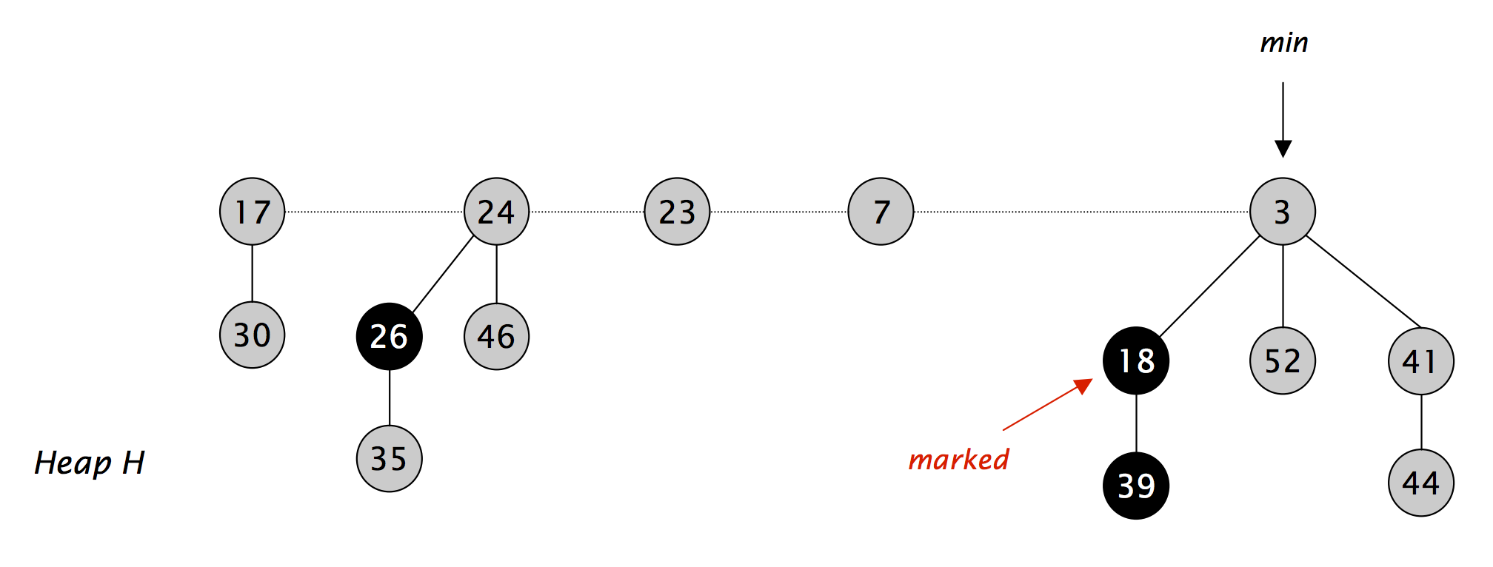
More Varieties of Heaps: Fibonacci heap
Fibonacci heap
  Especially useful when deleteMin() & delete(n) are rarely called ➔ amortized O(log n)
  All other operations are O(1)

Slide 26
Fibonacci Heap
Basic idea
  Similar to binomial heaps, but less rigid structure
  Binomial heap: eagerly consolidate trees after each insert (maintain binomial structure)
  Fibonacci heap: lazily defer consolidation until next delete-min
Properties
  Set of heap-ordered trees.
  Maintain pointer to minimum element
  Set of marked nodes (if one of its children is removed)
(Ref) https://www.cs.princeton.edu/~wayne/teaching/fibonacci-heap.pdf

Slide 27
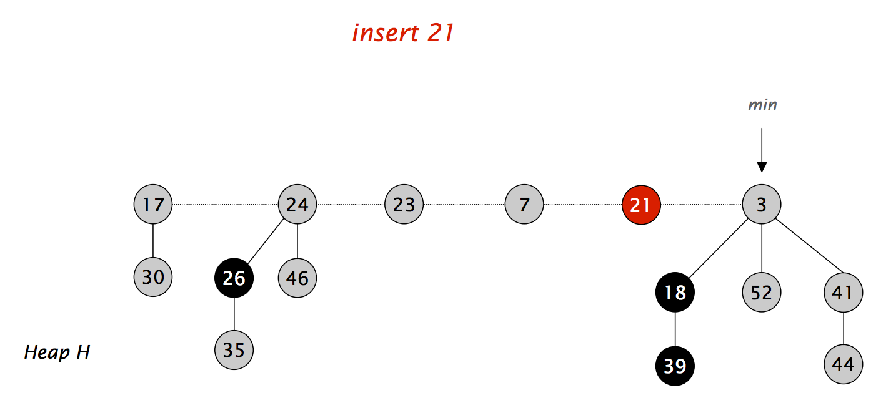
Fibonacci Heap: Insert Operation
Create a new singleton tree.
Add to root list; update min pointer (if necessary) ➔ O(1)
(Ref) https://www.cs.princeton.edu/~wayne/teaching/fibonacci-heap.pdf

Slide 28
Fibonacci Heap: DeleteMin Operation
Let H be a Fibonacci heap and x be a node
  rank(x): number of children of node x
  rank(H): max rank of any node in heap H
  tree(H): number of trees in heap H
DeleteMin
  Delete min; meld its children into root list; update min
  Consolidate trees so that no two roots have same rank // What about the min pointer?
  ➔ Time complexity: O(rank(H)) + O(trees(H))
  ➔ Amortized cost: O(rank(H))
Notes:
O(rank(H)) + O(trees(H))
Number of trees after the root is meld.

Slide 29
Heap Operations Supported in STL
STL does not have a “heap” class
  Instead, it support several operations that can operate on “array” like data structure
Operations
  void make_heap(first, last[, comp]);
  void push_heap(first, last[, comp]);
  void pop_heap(first, last[, comp]);
  void sort_heap(first, last[, comp]);
  bool is_heap(first, last[, comp]);
  ➔ fist, last: RandomAccessIterator
  ➔ comp: StrictWeakOrdering (optional)

Slide 30
Heap Operations Supported in STL (Example)
{
int size = 100;
int arr[size];
// write data to arr
…
make_heap(arr, arr+size);
int min = arr[0];
pop_heap(arr, arr+(--size));
arr[size++] = min*min;
push_heap(arr, arr+size);
sort_heap(arr, arr+size);
// heap is now sorted
}

Slide 31
Summary: Heap Structures
Pros:
  Good complexity of “insert”, “delete min(max)”, ... operations
  Simple data structure (low memory overhead)
  Simpler algorithms (than BST)
Con
  Data are not sorted
  ➔ Still have O(n) for “find” operation

Slide 32
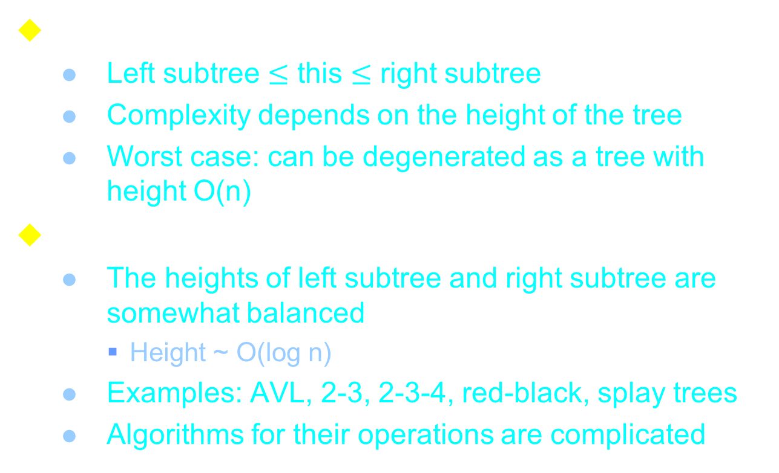
Review: Binary Search Trees
Binary Search Trees (BSTs)
  Left subtree $≤$ this $≤$ right subtree
  Complexity depends on the height of the tree
  Worst case: can be degenerated as a tree with height O(n)
Balanced BSTs
  The heights of left subtree and right subtree are somewhat balanced
    Height ~ O(log n)
  Examples: AVL, 2-3, 2-3-4, red-black, splay trees
  Algorithms for their operations are complicated

Slide 33
Sorted ADT in STL
Also classified as “Associative Containers”
set
multiset
map
multimap
➔ Implemented in “red black tree”

Slide 34
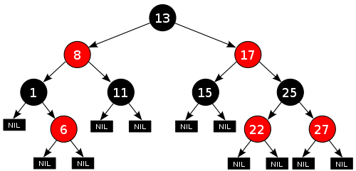
Red Black Tree (More to cover later)
A node is either red or black. The root is black
All leaves are black (i.e. All leaves are same color as the root.)
Every red node must have two black child nodes.
Every path from a given node to any of its descendant leaves contains the same number of black nodes.
Memory efficient
Although balancing
is NOT perfect,
O(log n) for insert,
delete, and find

Slide 35
class set in STL
To store elements in a set
  e.g. { 2, 3, 5, 7, 9 }
set<Key[, Compare, Alloc]>
  class Key: element type
  class Compare: how the elements are compared (optional; default = less<Key>)
  class Alloc: used for internal memory management (optional; default = alloc)

Slide 36
Member Functions in class set
iterator begin() const;
iterator end() const;
pair<iterator, bool> insert(const value_type& x);
iterator insert(iterator pos, const value_type& x);
void insert(InputIterator, InputIterator);
void erase(iterator pos);
size_type erase(const key_type& k);
void erase(iterator first, iterator last);
iterator find(const key_type& k) const;
size_type count(const key_type& k) const;
iterator lower_bound(const key_type& k) const;
iterator upper_bound(const key_type& k) const;
pair<iterator, iterator> equal_range(const key_type& k) const;

Slide 37
Other Functions for class set
includes
  Check if one set is included in another
set_union
set_intersection
set_difference
set_symmetric_difference
  (A – B) U (B – A)

Slide 38
class multiset in STL
Unlike “set”, where elements with same value are stored only once, in multiset, they can be stored repeatedly
  e.g. { 2, 3, 5, 5, 6, 7, 7, 7 }
multiset<Key[, Compare, Alloc]>
  class Key: element type
  class Compare: how the elements are compared (optional; default = less<Key>)
  class Alloc: used for internal memory management (optional; default = alloc)

Slide 39
class map in STL
In many applications, data are associated with keys (or id’s)
  For example, (id, student record)
  e.g. { (Mary, 90), (John, 85), (Sam, 71) ... }
class map<Key, Data[, Compare, Alloc]>
  class Key: compared data type
  class Data: value type
  class Compare: how the elements are compared (optional; default = less<Key>)
  class Alloc: used for internal memory management (optional; default = alloc)

Slide 40
Example of using class map (1)
map<string, unsigned> scoreMap;
scoreMap[“Mary”] = 90;
scoreMap[“John”] = 85;
scoreMap[“Sam”] = 71;
unsigned maryScore = scoreMap[“Mary”];
cout << “Mary’s score = “ << maryScore << endl;
map<string, unsigned>::iterator mi;
mi = scoreMap.find(“John”);
if (mi != scoreMap.end())
cout << “John’s score = “ << (*mi).second << endl;
➔ How about “map<const char*, unsigned>”?

Slide 41
Comments about map::operator []
Since operator[] might insert a new element into the map, it can't possibly be a const member function.
Note that the definition of operator[] is somehow tricky: m[k] is equivalent to (*((m.insert(value_type(k,data_type()))).first)).second.
  value_type = pair<Key, Data>
  insert(value_type) returns a pair<map::iterator, bool>
Strictly speaking, this member function is unnecessary: it exists only for convenience.
http://www.sgi.com/tech/stl/Map.html

Slide 42
Bad example of using class map
map<const char*, unsigned> mmm;
map<const char*, unsigned>::iterator mi;
char buf[1024];
cin >> buf; mmm[buf] = 10;
cin >> buf; mmm[buf] = 20;
cin >> buf; unsigned s1 = mmm[buf];
cout << buf << “ = “ << s1 << endl;
cin >> buf; unsigned s2 = mmm[buf];
cout << buf << “ = “ << s2 << endl;

Slide 43
Example of using class map (2)
string str;
for (int i = 0; i < 5; ++i) {
cin >> str; mm.insert(pair<string, int>(str, i));
}
while (1) {
cin >> str;
map<string, int>::iterator mi = mm.find(str);
if (mi == mm.end()) {
cout << "Not found!!" << endl;
break;
}
cout << (*mi).first << " = " << (*mi).second << endl;
}

Slide 44
Conclusion: Set and Map
“set” and “map” are useful data structures when we need to perform efficient “insert”, “erase”, and “find” operations
  Usually implemented by balanced binary search trees
  Implementation efforts can be high
  Using STL may be a good choice
Remember, unbalanced BSTs may not be a bad choice
  Most randomly inserted BSTs are somewhat balanced
Remember, there’s no free lunch
  Overhead in insert (vs. push_back)
  If we don’t need to do “erase” or “find” during insertions... (what’s the alternative?)

